Slide 1

Motion Control：Lecture 5.3
The NURBS interpolation
Jiangang Li
14 Nov 2016

Slide 2
Content
Background and Motivation
Introduction to NURBS Curve and Curve Interpolation
Existing Interpolation Algorithms and Problems
Complete Off-line NURBS interpolation Algorithm
Simulation and Experiment Results
Conclusion
Harbin Institute of Technology Shenzhen Graduate School

Slide 3
Background and Motivation
Conventional approach for CNC machining
Line/Arc
Segments
Curve
Segmentation
Part Program
CAM
NC Code
CNC
CL Path
Motion
Planning
Cutter Offset &
Path Scheduling
Linear/Circular
Interpolator
Reference
Points
CC Path
Control Loops
Curve
Representation
CAD
CAD Model
Machine Tool

Slide 4
  CL(Curves)
  Line
  Arc
R
Converting curve of CL to lines and arc form

Slide 5
Background and Motivation
Drawbacks of Conventional approach
Contradiction between accuracy and size of data
Deteriorate the smooth of the surface
Discontinuity of velocity and acceleration

Slide 6
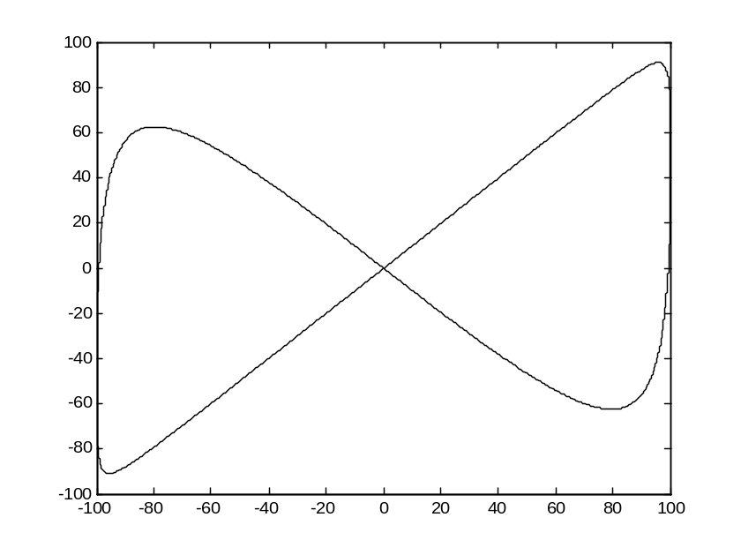
Simulation and Experiment Results
Example of NURBS:
Control points:
[(0,0,0), (-100,-100,0), (-100,100,0),
(25,0,0), (100,-100,0), (100,100,0),
(0,0,0)]
Weight: W=[1 30 10 1 10 30 1]
Knot vector: U=[0 0 0 ¼ ½ ½ ¾ 1 1 1]
Interpolation period: Ts=0.002s
Trapezoidal feedrate profile: F=200mm/s, A=200mm/s^2

Slide 7
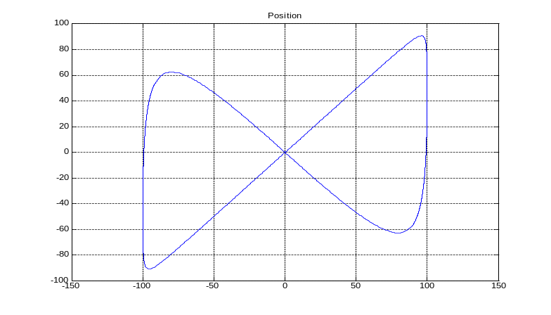
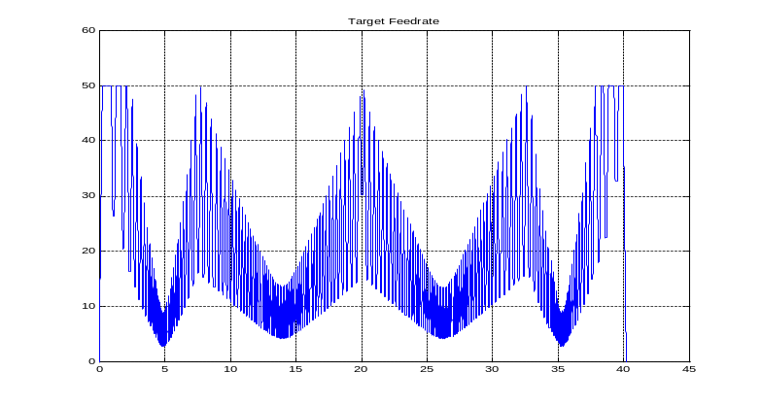
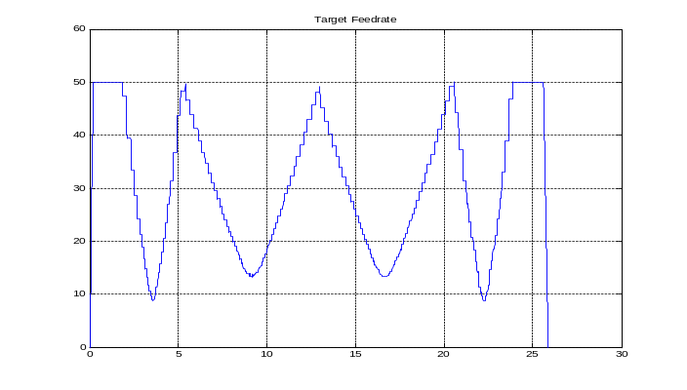


3 Multi-section velocity plan and interpolate
Fig 3.11 Continuous tool path for simulation
Fig 3.12 Velocity plan with
machining time is about 40s
Fig 3.13 Velocity plan with
machining time is about 25s

Slide 8
Background and Motivation
Proposed approach for CNC machining
Line/Arc/curve
Segments
Curve
Segmentation
Part Program
CAM
NC Code
CNC
CL Path
Motion
Planning
Cutter Offset &
Path Scheduling
Linear/Circular/curve
Interpolator
Reference
Points
CC Path
Control Loops
Curve
Representation
CAD
CAD Model
Machine Tool

Slide 9


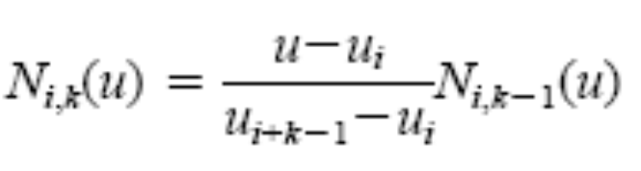




Introduction to NURBS Curve and Curve Interpolation
Formula of NURBS:
Where,
is the control point,
is the weight,
is the knot vector.

Slide 10
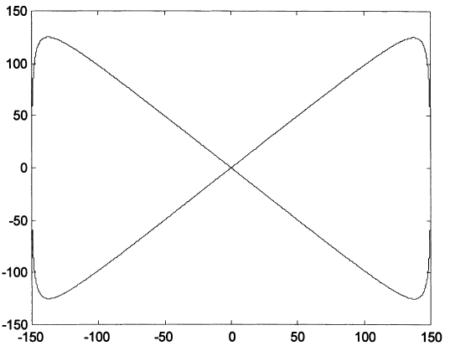
Existing Interpolation Algorithms and Problems
Example of NURBS:
Control points:
[(0,0,0), (-150,-150,0), (-150,150,0),
(0,0,0), (150,-150,0), (150,150,0),
(0,0,0)]
Weight: W=[1 25 25 1 25 25 1]
Knot vector: U=[0 0 0 ¼ ½ ½ ¾ 1 1 1]

Slide 11
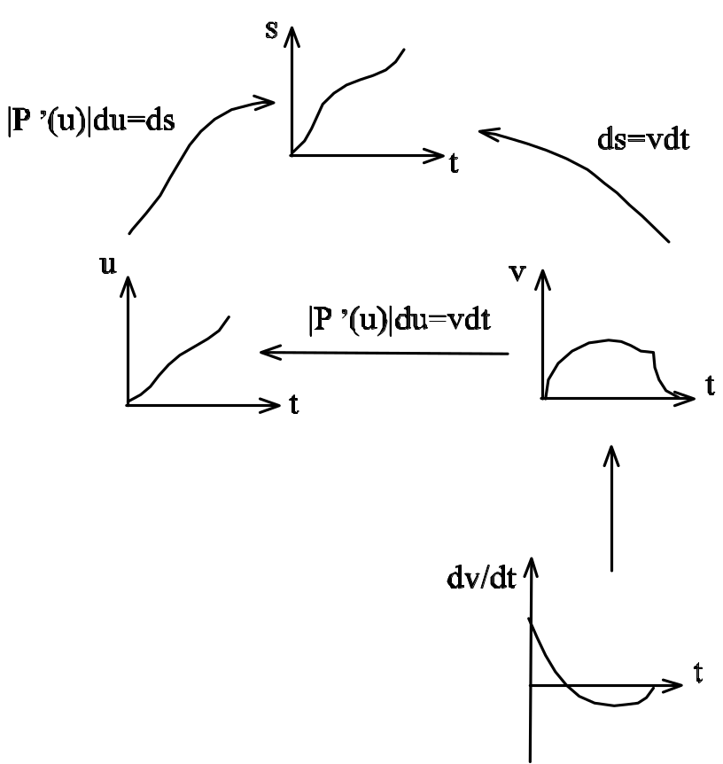
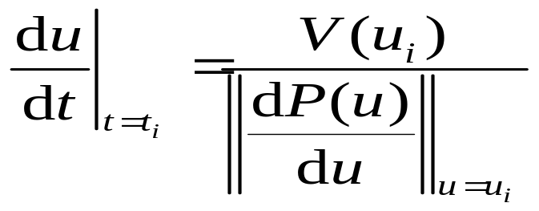

Introduction to NURBS Curve and Curve Interpolation
Relations between u and t
Where, is given as the
designed feedrate.

Slide 12


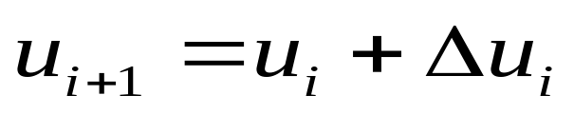

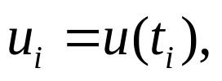


Introduction to NURBS Curve and Curve Interpolation
The general parameter iteration method:
Problem: How to solve the differential
equation efficiently?

Slide 13
Existing Interpolation Algorithms and Problems
Existing interpolation algorithms
Taylor’s first- and second-order approximation
The speed-controlled method
Runge-Kutta method
The predictor-corrector method

Slide 14
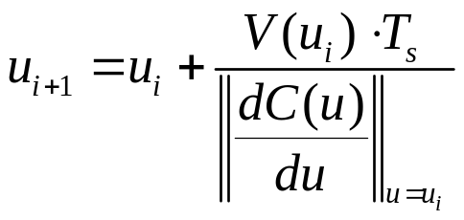
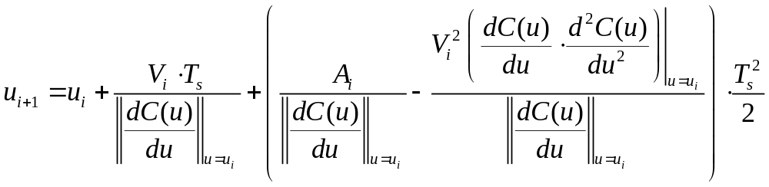
Existing Interpolation Algorithms and Problems
Taylor’s first- and second-order approximation
(Shpitalni et al. and Yang, Kong )
The first-order approximation:
The second-order approximation:

Slide 15
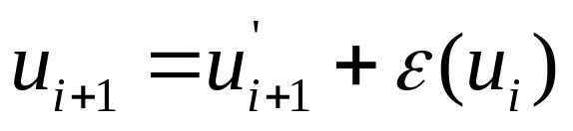
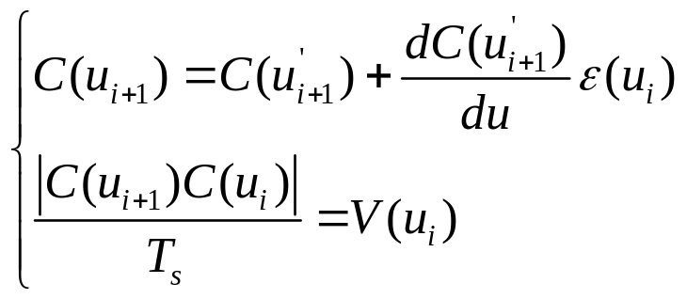
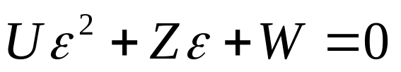
Existing Interpolation Algorithms and Problems
The speed-controlled method (Yeh and Hsu )
Applying the Taylor’s expansion of Curve C with respect to u, and
considering the calculation of the speed, then
By calculating, one root is near zero, and the other root is negative
and relative large .

Slide 16
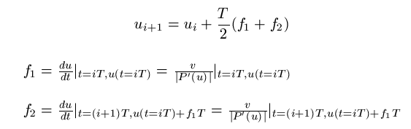
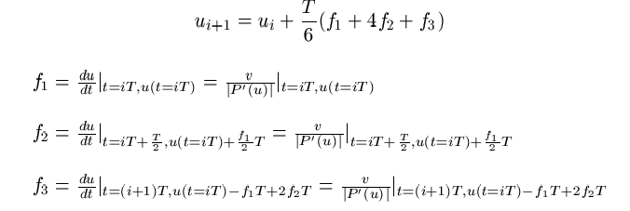
Existing Interpolation Algorithms and Problems
Runge-Kutta method(2nd,3rd)

Slide 17
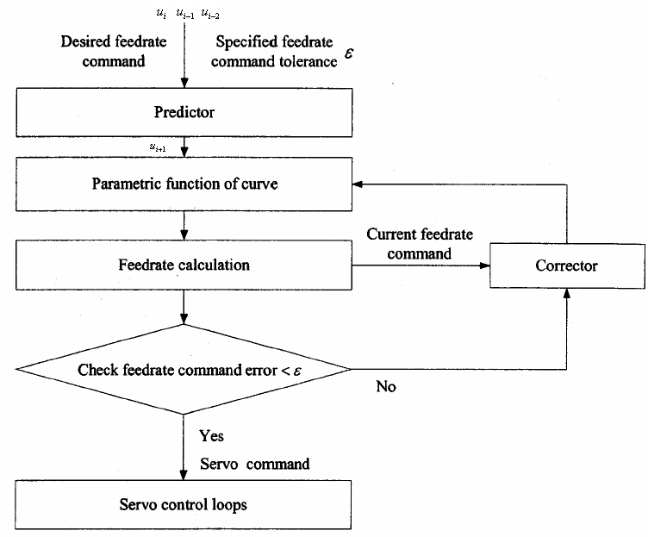
Existing Interpolation Algorithms and Problems
The predictor-corrector method (Tsai and Cheng)

Slide 18
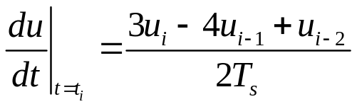


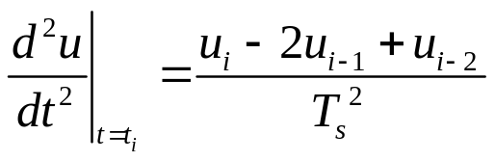

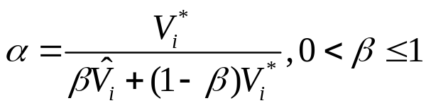
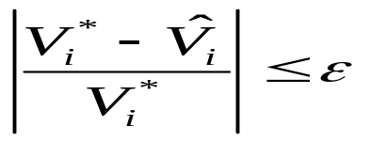
Existing Interpolation Algorithms and Problems
Predictor:
Corrector:
Terminated condition:

Slide 19
Existing Interpolation Algorithms and Problems
Example of NURBS:
Control points:
[(0,0,0), (-150,-150,0), (-150,150,0),
(0,0,0), (150,-150,0), (150,150,0),
(0,0,0)]
Weight: W=[1 25 25 1 25 25 1]
Knot vector: U=[0 0 0 ¼ ½ ½ ¾ 1 1 1]
Interpolation period: Ts=0.002s
Trapezoidal feedrate profile: F=200mm/s, A=300mm/s^2

Slide 20
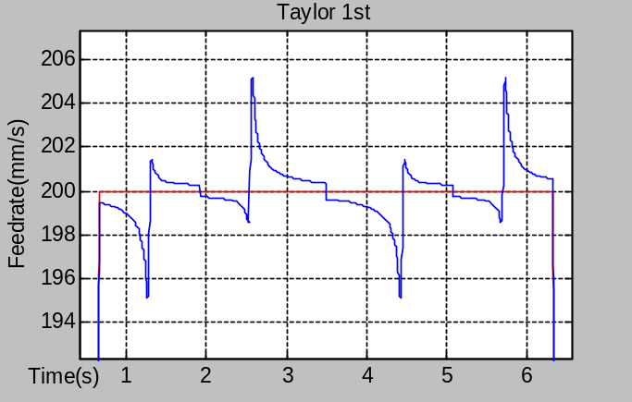
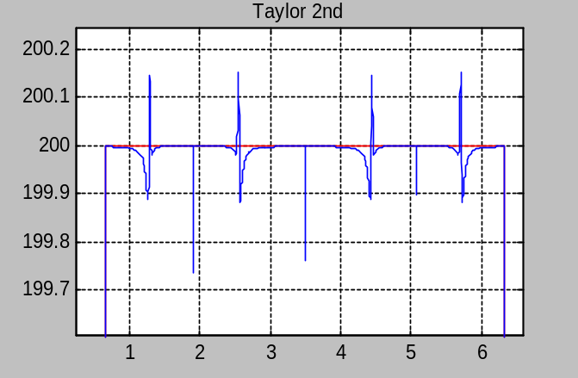
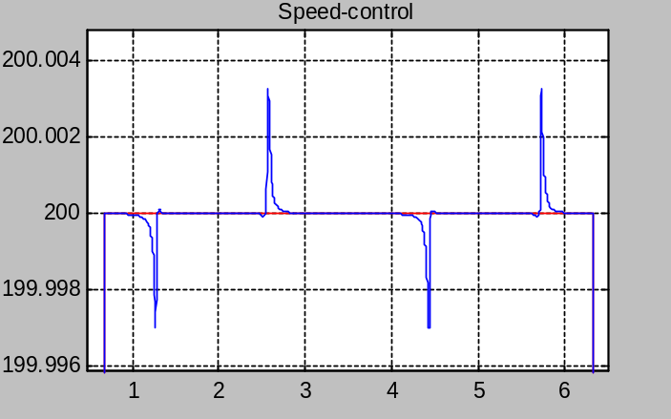
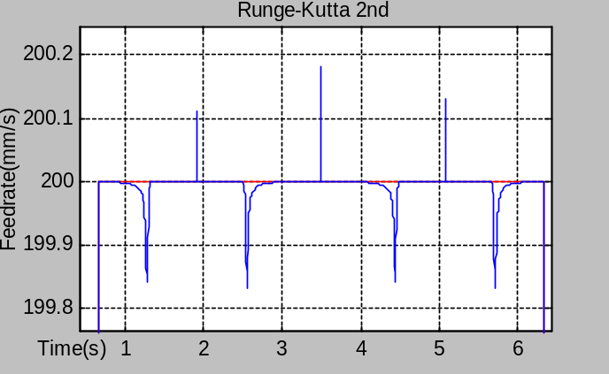
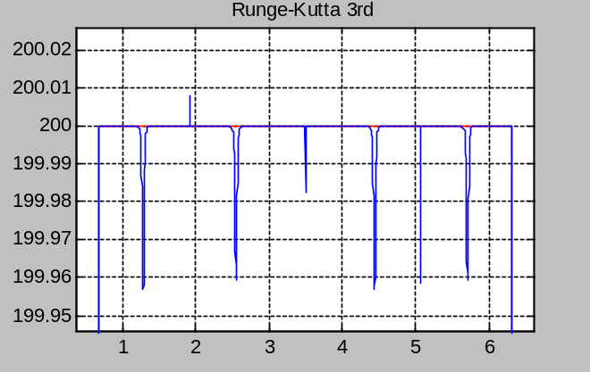
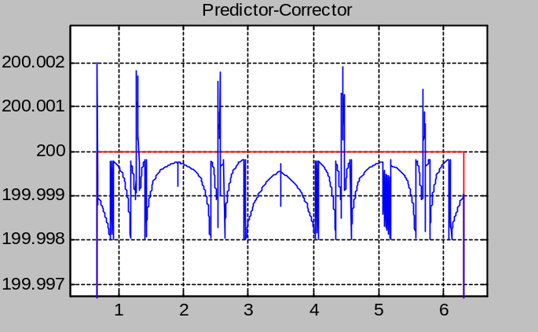
Existing Interpolation Algorithms and Problems
Red curve ------ profile feedrate; Blue curve ------ Real feedrate

Slide 21
Existing Interpolation Algorithms and Problems
Type | The maximum speed fluctuation radio | The maximum chord error (mm) | Computation time (s)
Taylor 1st | 0.0258336 | 0.0036190 | 1.218
Taylor 2nd | 0.0013170 | 0.0035480 | 1.234
Speed-control | 0.0000164 | 0.0035427 | 1.297
Runge-Kutta 2nd | 0.0009029 | 0.0035370 | 1.406
Runge-Kutta 3rd | 0.0002155 | 0.0035413 | 1.453
Predictor-Corrector(0.001%) | 0.0000099 | 0.0035427 | 1.281
Predictor-Corrector(0.1%) | 0.0009987 | 0.0035427 | 1.265
Speed accuracy: Taylor 1st <Taylor 2nd < Runge-Kutta 2nd < Runge-Kutta 3rd < Speed-control < Predictor-corrector (E=0.00001)

Slide 22

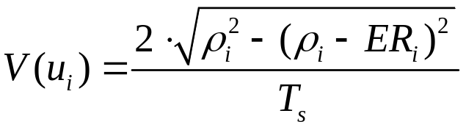



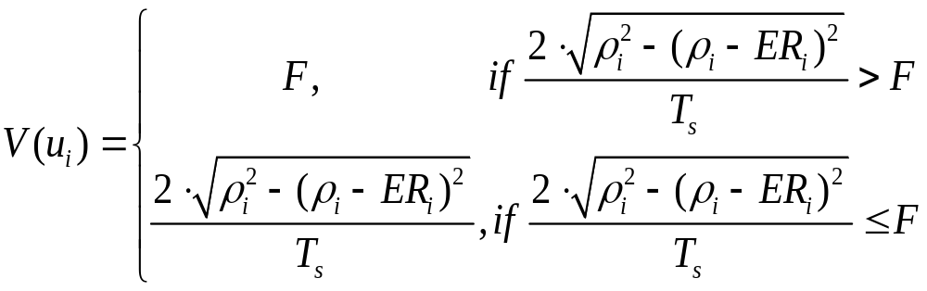
Existing Interpolation Algorithms and Problems
Adaptive-feedrate algorithm
(Yeh and Hsu )
Circle
Curve

Slide 23
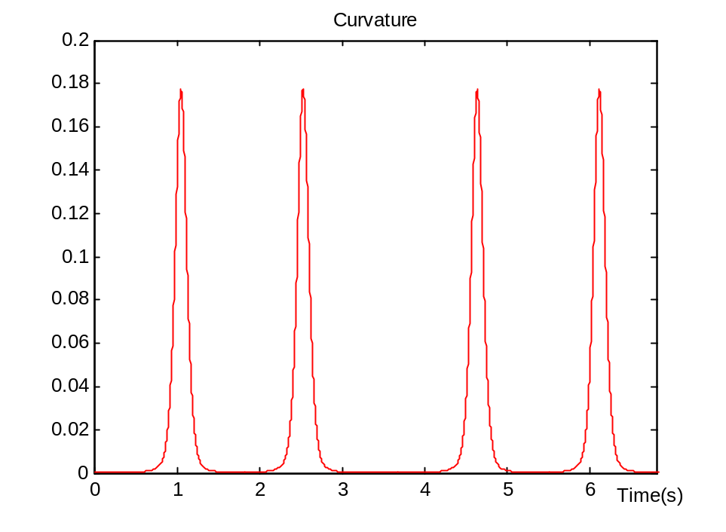
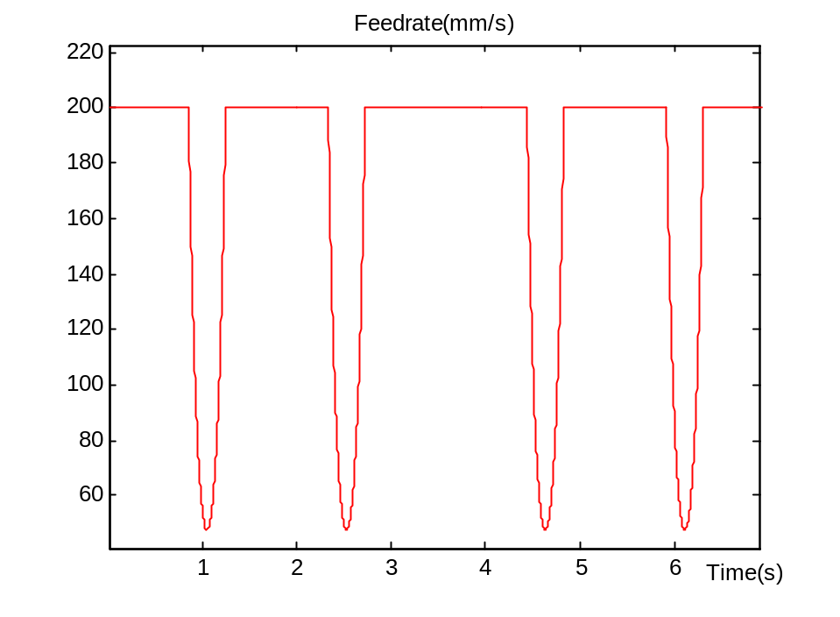
Existing Interpolation Algorithms and Problems
Simulation results

Slide 24
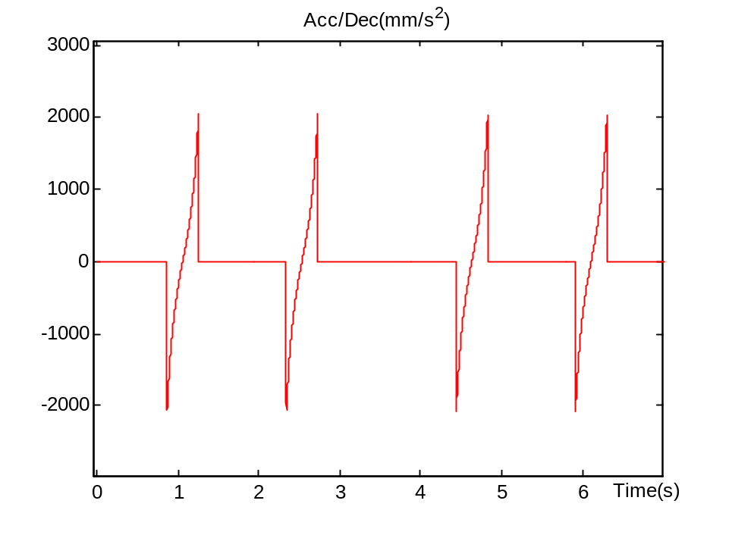
Existing Interpolation Algorithms and Problems
Dynamical constraints: acc/dec capability
An algorithm is needed
to confine the acc/dec!

Slide 25
Complete Off-line NURBS Interpolation Algorithm
Input: Feedrate curve obtained from adaptive-feedrate
algorithm, S(u).
Step1: Detect and identify the feedrate sensitive corner.
Step2: Determine the new start and end points of each
acceleration/deceleration block. (Narayanaswami and Yong)
Step3: Modify the feedrate curve so that there is no any
intersection or discontinuity.

Slide 26




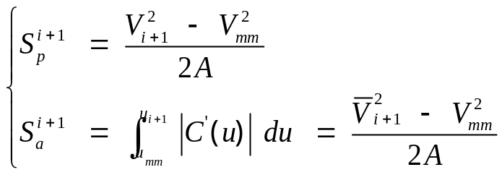









Complete Off-line NURBS Interpolation Algorithm
Acceleration block :
Satisfying conditions: 1.
2. Constant acceleration rate
1. If
Increase to
such that
then

Slide 27

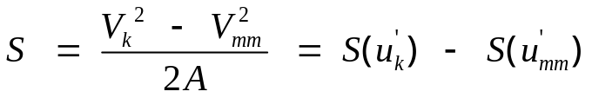



Complete Off-line NURBS Interpolation Algorithm
2. If
then
Method to figure out the end point:
and

Slide 28
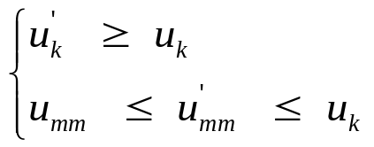


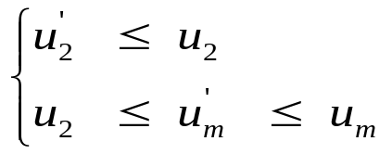


Complete Off-line NURBS Interpolation Algorithm
Two restrictions:
1. For acceleration block,
2. For deceleration block,

Slide 29
Complete Off-line NURBS Interpolation Algorithm
Read in the acceleration/deceleration block one by one and compare it with the previous blocks!!!
Case1: SEG2 is an acceleration block and SEG1 is a deceleration one.
Case2: SEG2 is an acceleration block and so is to SEG1.

Slide 30
Complete Off-line NURBS Interpolation Algorithm
Case3: SEG2 is an deceleration block and so is to SEG1.
Case4: SEG2 is a deceleration block and SEG1 is an acceleration one.

Slide 31
Complete Off-line NURBS Interpolation Algorithm

Slide 32


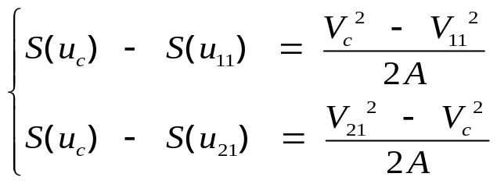



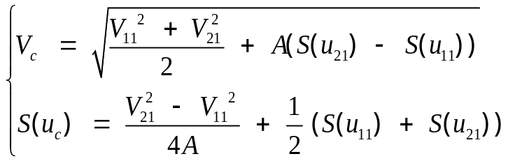


Complete Off-line NURBS Interpolation Algorithm
A typical case:

Slide 33
Complete Off-line NURBS Interpolation Algorithm
Modification results:

Slide 34
Complete Off-line NURBS Interpolation Algorithm

Slide 35
Simulation and Experiment Results
Example of NURBS:
Control points:
[(0,0,0), (-100,-100,0), (-100,100,0),
(25,0,0), (100,-100,0), (100,100,0),
(0,0,0)]
Weight: W=[1 30 10 1 10 30 1]
Knot vector: U=[0 0 0 ¼ ½ ½ ¾ 1 1 1]
Interpolation period: Ts=0.002s
Trapezoidal feedrate profile: F=200mm/s, A=200mm/s^2

Slide 36
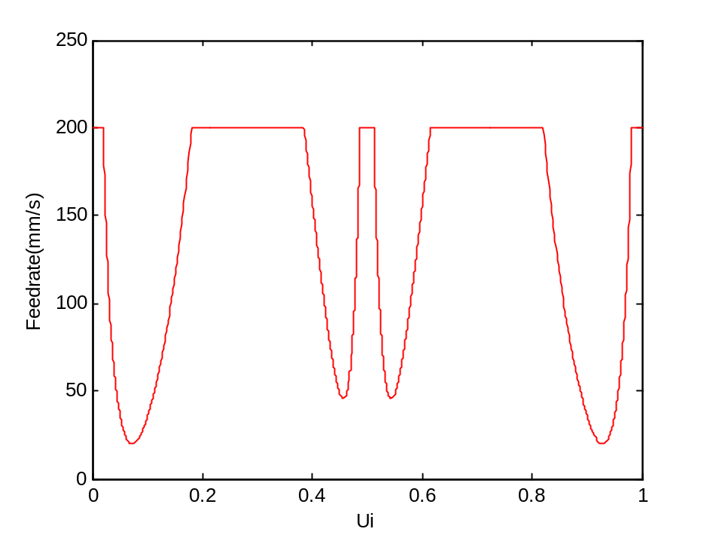
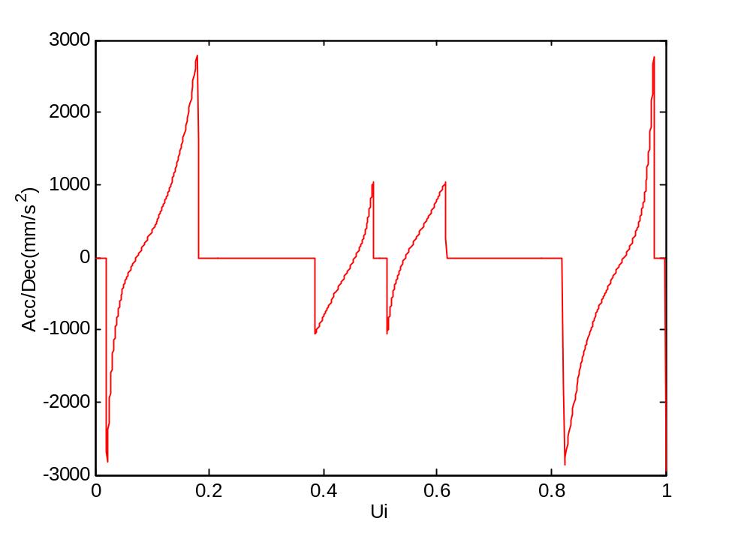
Simulation and Experiment Results
By applying adaptive-feedrate algorithm:

Slide 37
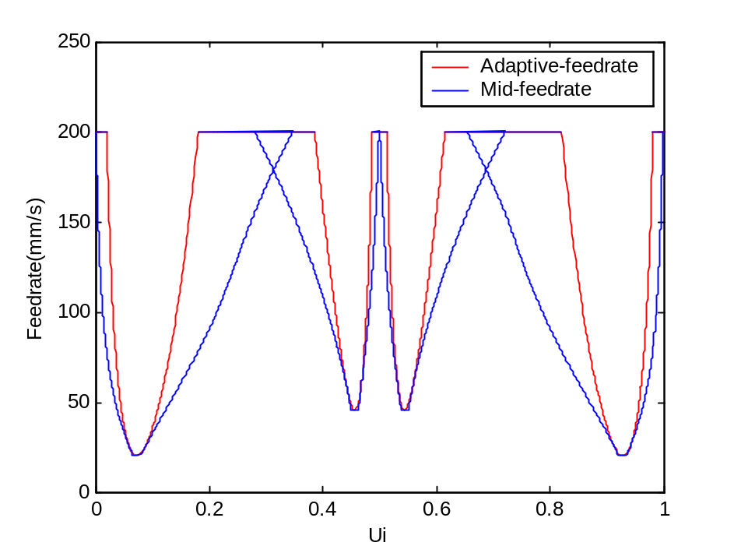
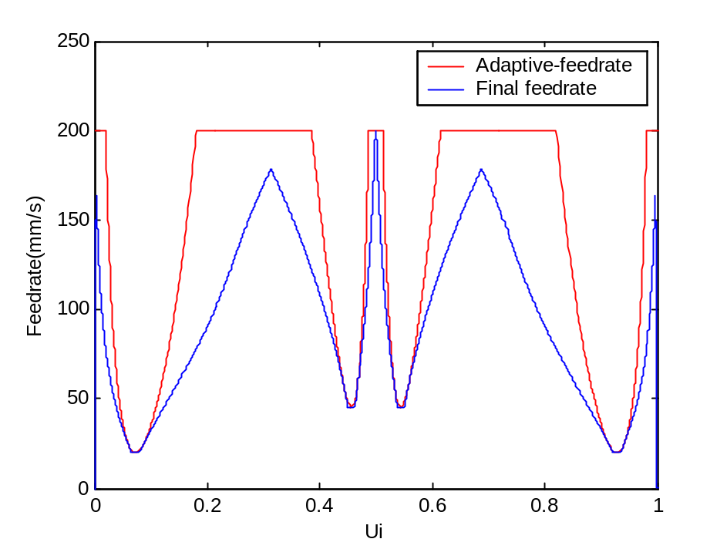
Simulation and Experiment Results
By applying modification algorithms:

Slide 38
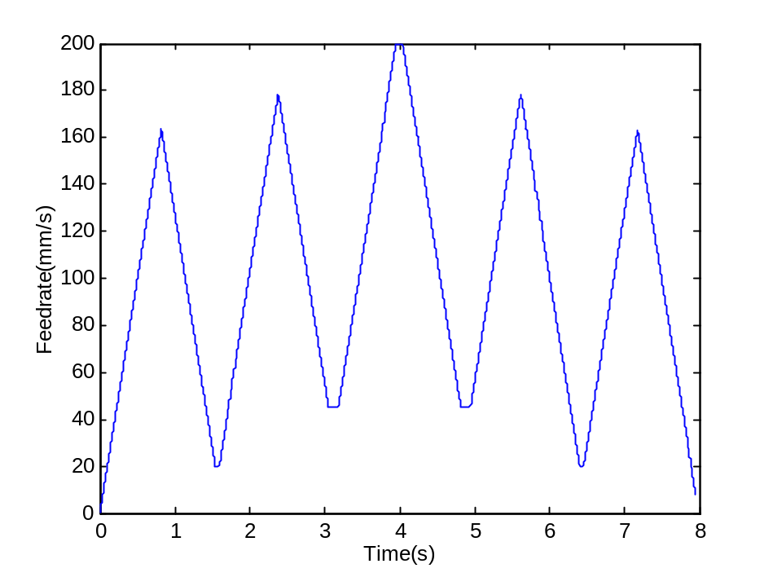
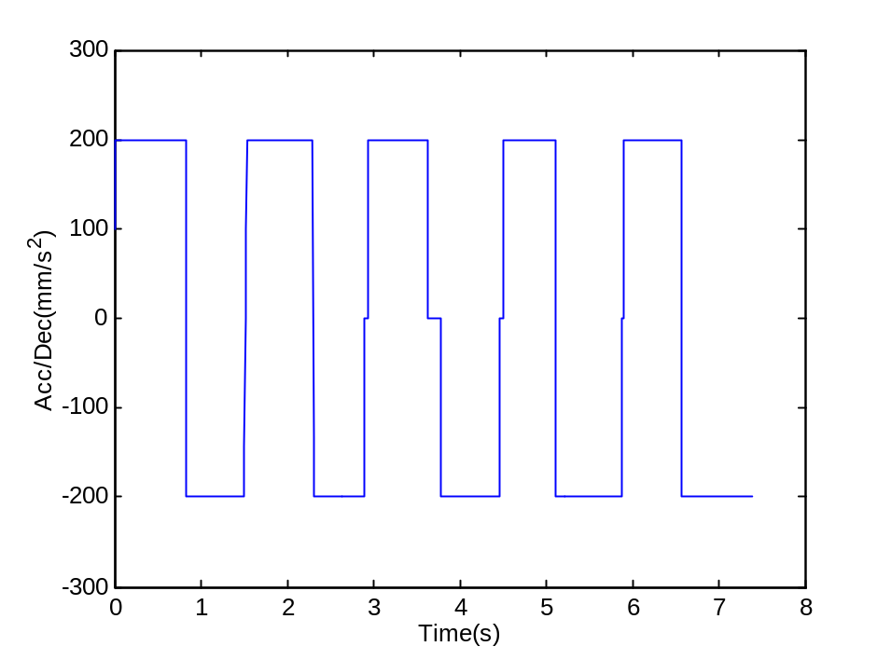
Simulation and Experiment Results
By applying modification algorithms:

Slide 39
Conclusion
Speed error is limited.
Chord error is confined to the satisfied tolerance.
Acceleration and deceleration can satisfy the
capability of the machine tool.
Wide application.
Better machining quality.

